Slide 1
Explaining the Effects of Data Augmentation Techniques with Convolutional Neural Networks
Presenter: Xiongjie Dai (xdai12), Yu He (yuhe6), Mengjia Zeng (mengjia6)
Date: 05/07/2022

Slide 2
Introduction
Computer Vision – Deep Convolutional Neural Networks (CNN) are capable of classifying images.
Many application domains of image classification → no big amount of data → Limit the application of CNN.
Data Augmentation Techniques → Useful

Slide 3
Related Work
Wang, et al. compared among several data augmentation techniques (2018)
0.855 to 0.890 (Compare Dogs and Goldfishes)
0.705 to 0.755 (Compare Dogs and Cats)
Mikołajczyk, et al. compared among traditional data augmentation techniques (2017)
Cropping, flipping and rotating perform better than the others on CIFAR-10 and ImageNet.

Slide 4
Related Work
Our study has some differences than the study before:
Use a less used dataset - Oxford-IIIT Pet dataset.
Try five different traditional data augmentations - flipping, rotating, cropping, coloring and blurring.
Try to check generalizability under different situations.

Slide 5
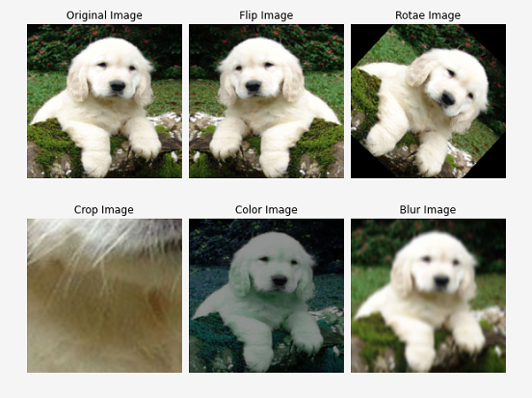
Methods
Artificially divide the dataset with 4,800 images to two classes of cats and dogs
Split into training and testing with a split of 80:20.
Resize → Augmentation → Tensor Format

Slide 6
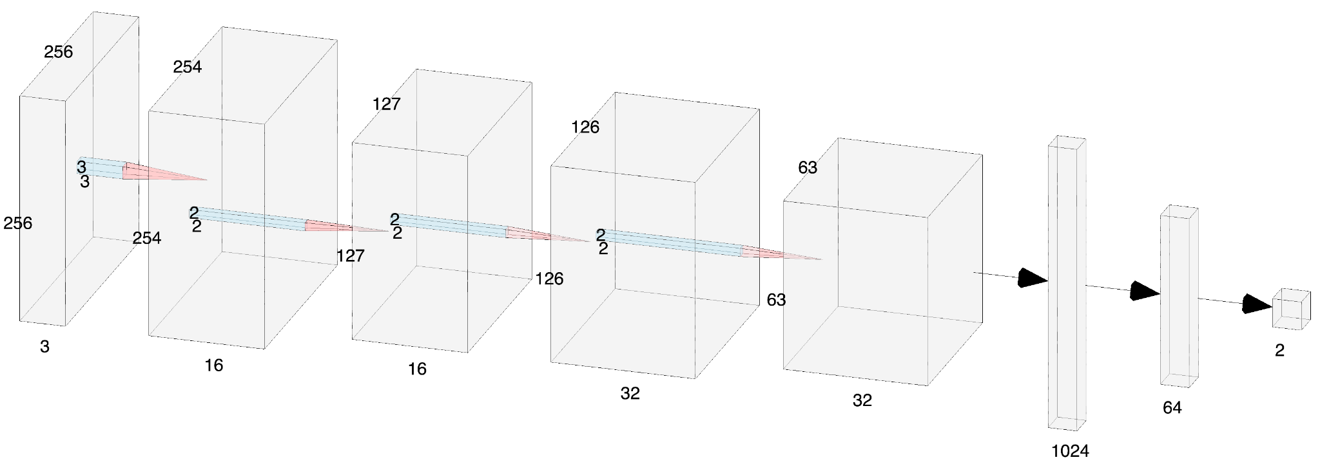

Methods
In order to check generalizability, we try three different CNN models, SmallNet1, SmallNet2 and SmallNet3, with three seeds, 1, 2 and 3.
SmallNet1 → 2 convolution + 2 pooling layers
SmallNet2 → 3 convolution + 2 pooling layers
SmallNet3 → 3 convolutional layer + 2 pooling layers + 1 inception layer

Slide 7
Methods
Under each situation (Model + Seed) → Train with 10 epochs → Compare the accuracy of the last epoch among those with augmentation or without.
Choose SGD Optimizers with different parameter of weight decay.
Learning Rate: 0.01, Momentum: 0.8 (SmallNet1 and SmallNet2)
L2 regularization with weight decay chosen by situation under SmallNet1 and Seed 1.
Learning Rate: 0.001, Momentum: 0.8 (SmallNet3)

Slide 8
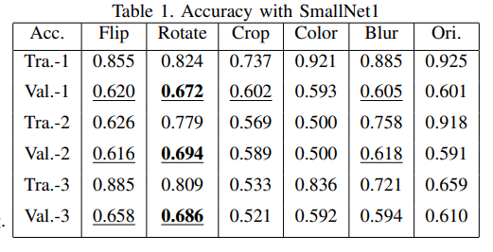
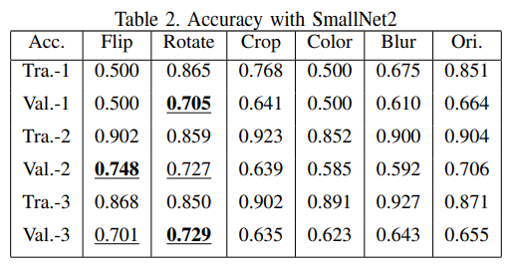
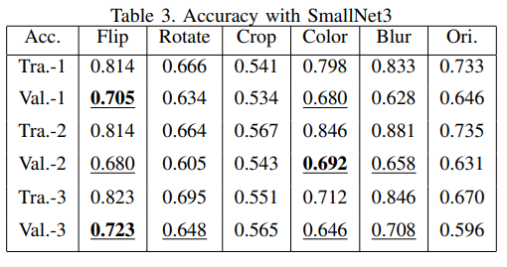
Results - Testing Accuracy

Slide 9
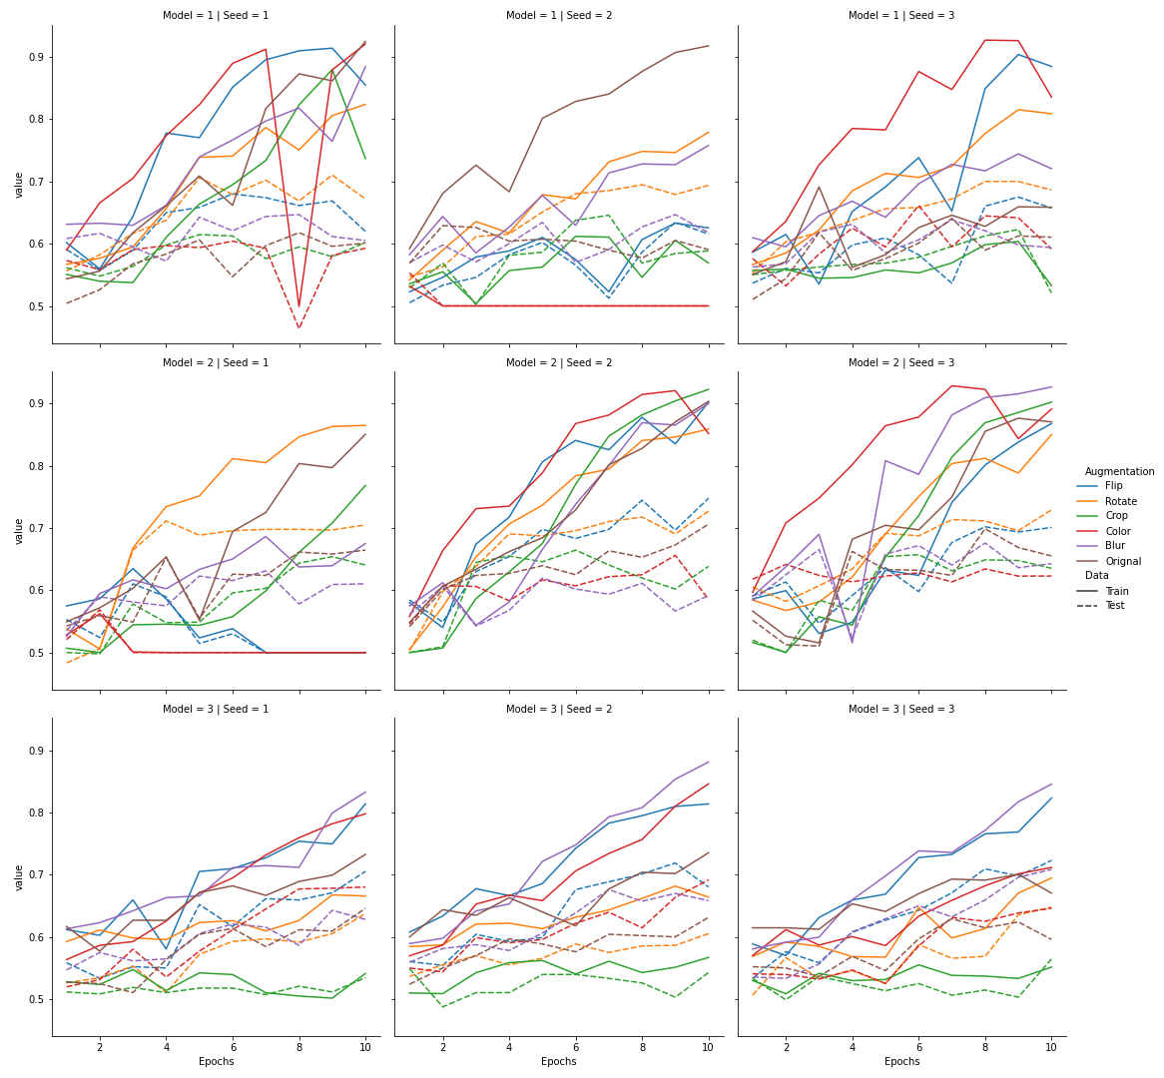
Results - Accuracy Graph
Best one – SmallNet2 + Seed2 + Flipping
Testing Accuracy → 0.748

Slide 10
Conclusions
Flipping always performs well for three different models.
Rotating performs well under SmallNet1 and SmallNet2. → Bad performance in SmallNet3 may result from the inception layer.
Performance of coloring increases a lot under SmallNet3 → May also result from the inception layer.

Slide 11
Conclusion - Limitations
This study only trains the CNN models with 10 epochs.
Have larger gap between training accuracy and testing accuracy with more epochs → Possible with Overfitting
May need more tries with regularization
In some situations, the training and testing accuracy stucks at 0.5, meaning that the model fails to have a good fit.
May need to try more combinations of hyperparameters
Use other optimization techniques other than SGD, like Adam

Slide 12
Conclusion - Future Work
Extend the study with dataset with more than 2 classes.
Try to check whether the predicting accuracy for each class increases as the whole testing accuracy increases.
Try more data augmentation techniques, or even some combinations of data augmentation.

Slide 13
Thanks for Listening!

